Slide 1

Creating a comprehensive NLP solution
Explore Azure's powerful text analysis capabilities using Python.
by Vaishnavi Agrahari

Slide 2

Setting Up the Environment
1
Load Environment Variables
Use dotenv to manage configuration settings.
2
Import Azure Namespaces
Utilize TextAnalyticsClient and AzureKeyCredential classes.
3
Create Client
Initialize TextAnalyticsClient with endpoint and credentials.

Slide 3




Processing Text Files
Iterate Through Files
Loop through text files in reviews folder.
Read File Contents
Open and read each file's text.
Prepare for Analysis
Pass text to Azure AI services.

Slide 4

Language Detection
Function Call
Return Value
Use detect_language method on client.
Receive DetectedLanguage object.
Extract Information
Access primary_language.name for detected language.

Slide 5




Sentiment Analysis
Positive
Neutral
Negative
Indicates favorable sentiment in text.
Shows balanced or objective sentiment.
Reflects unfavorable sentiment in content.

Slide 6
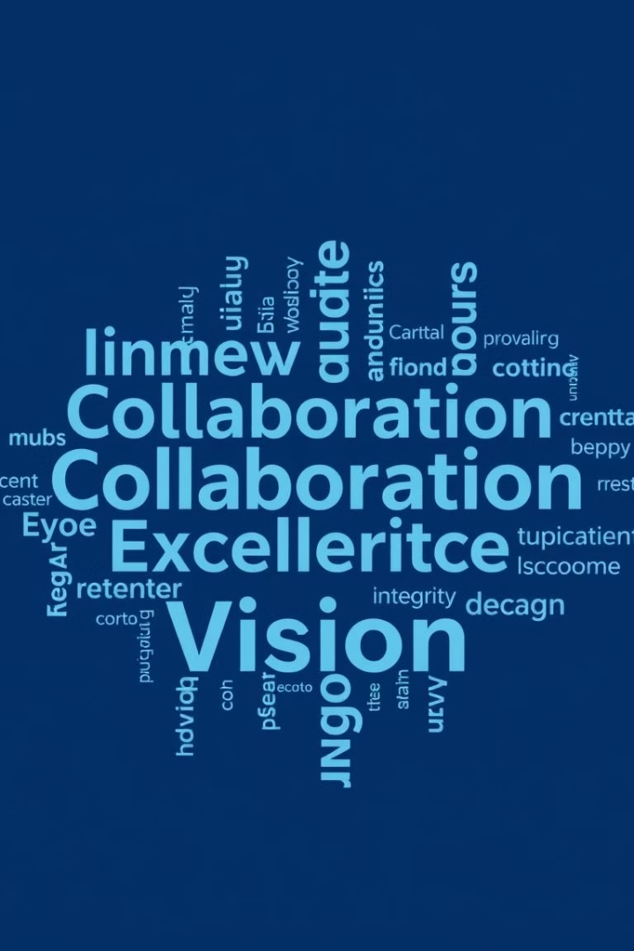
Key Phrase Extraction
1
Function Call
2
Result Processing
Utilize extract_key_phrases method.
Iterate through returned key phrases list.
3
Output Display
Print each extracted key phrase.

Slide 7
Entity Recognition
Named Entities
Linked Entities
Output Format
Identify and categorize entities in text.
Connect recognized entities to knowledge base.
Display entity text, category, and linked URL.

Slide 8
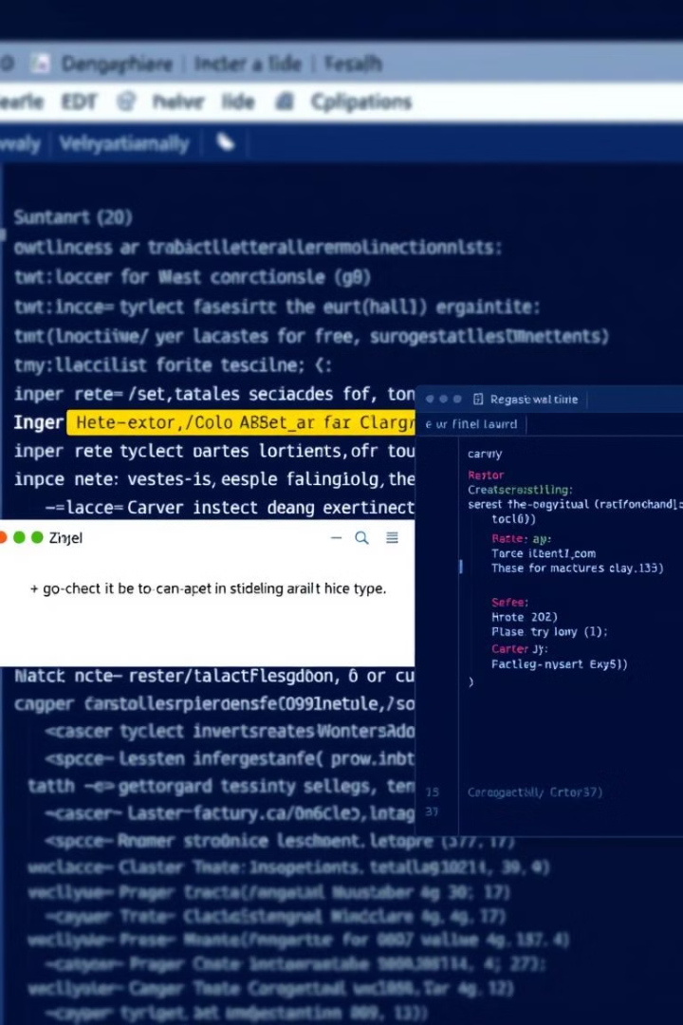
Error Handling and Execution
Try-Except Block
Catch and print exceptions
Main Function
Encapsulates analysis logic
Script Execution
Runs when file is primary

Slide 9
THANK YOU!!

